Slide 1
File Management System
Anit Chaudhary [BEIT(Mrng.) 12402 ]
Bipin Subedi [BEIT(Mrng.) 12402 ]
Suresh Pokhrel [BEIT(Mrng.) 12448 ]

Slide 2
Outline
Scenario & Problem
Motivations
Requirements Analysis
Scope
System Design: System Architecture
System Design: Class Diagram
Technologies used
Limitations and Enhancements

Slide 3
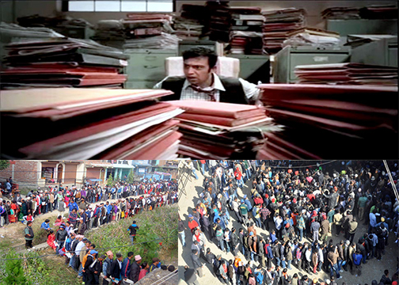
Scenario & Problem

Slide 4
Motivations
Queuing of people in Government Offices.
Months to get small work done.
Handy works preferred rather Digital usage.

Slide 5
Requirement Analysis
Platform Independent
Web Application
Easy Navigation of Files
User Validation
Resource Maintenance
Information Center

Slide 6
What now???
File Management System
How to use?
Why should I use?
What it can do for me?
Who is targeted?
What are features?
Is it for me?

Slide 7
Scope
Safe and secure resource reservation
Accessible from any device
Fast Work in Digital Environment
Targeted to Governmental Organizations
Mapping to files created

Slide 8
System Design
Use case Diagram
Activity Diagram
Class Diagram

Slide 9
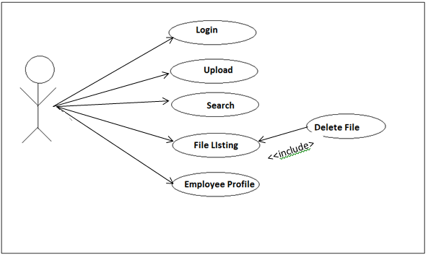
Use-case Diagram

Slide 10
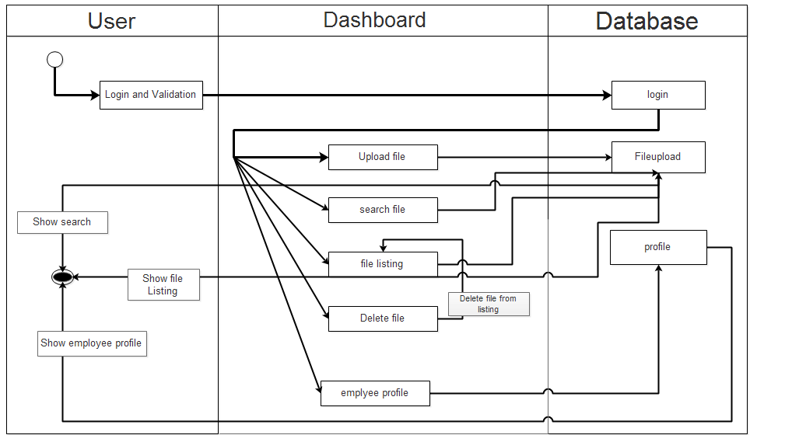
Activity Diagram

Slide 11
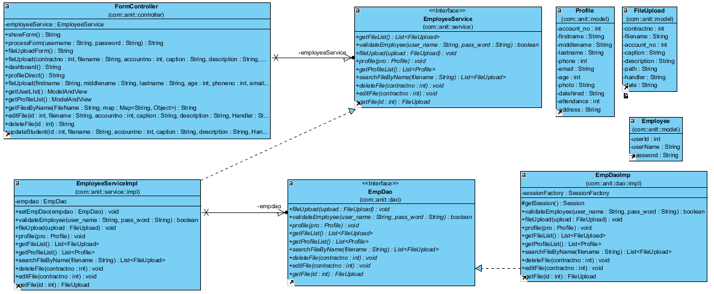
Class Diagram

Slide 12
Technologies used
JDK 1.7(Java Development Kit)
Spring & Hibernate Framework
JSP, CSS, HTML, JavaScript
Spring, Hibernate, MySQL Connector Jars
Sublime Text

Slide 13
Limitations and Enhancements
Chat implementation
Upload file with drag and drop
Real time design and implementation
Assign username and password by user itself
Download not supported
Session and Photo per login

Slide 14
Thank you ☺

Slide 15
Queries So far???

